Slide 1
Chapter 4
Transaction Overview
Controlling Concurrent Behavior

Slide 2
Chapter Outline
Transaction Concept.
Four important properties of transactions.
Transaction State
Concurrent Executions and schedules
Recoverability
Lock-Based Concurrency Control
Recovering From a Crash

Slide 3
Transaction concept
A transaction is defined as any one execution of a user program in a DBMS and differs from an execution of a program outside the DBMS.
Executing the same program several times will generate several transactions.

Slide 4
Transaction concept (cont’d)
DBMS handles an execution of a user program, or transaction, as a series of reads and writes of database objects:
+To read a database object, it is first brought into main memory (specifically, some frame in the buffer pool) from disk, and then its value is copied into a program variable.
+To write a database object, an in-memory copy of the object is first modified and then written to disk.

Slide 5
Why Transactions?
Transaction concept (cont’d)
Database systems are normally being accessed by many users or processes at the same time.
  Both queries and modifications.
Unlike operating systems, which support interaction of processes, a DMBS needs to keep processes from troublesome interactions.

Slide 6
Example: Bad Interaction
Consider the operation of transferring $100 from the account numbered 123 to the account 456. We might first check whether there is at least $100 in account 123, and if so, we execute the following two steps:
1. Add $100 to account 456 by the SQL update statement: UPDATE Accounts
SET balance = balance + 100
WHERE acctNo = 456;
2.Subtract $100 from account 123 by the SQL update statement:
UPDATE Accounts
SET balance = balance - 100
WHERE acctNo = 123;
What happens if there is a failure after Step (1) but before Step (2).

Slide 7
2. Four important properties of transactions (ACID Transactions)
ACID transactions are:
  Atomic : Whole transaction or none is done. Users should not have to worry about the effect of incomplete transactions.
  Consistent : Database constraints preserved. Ensuring this property of a transaction is the responsibility of the user.
  Isolated : It appears to the user as if only one process executes at a time.
  Durable : a transaction has been successfully completed, its effects should persist even if the system crashes before all its changes are reflected on disk.

Slide 8
Example of Fund Transfer
2. Four important properties of transactions (cont’d)
Transaction to transfer $50 from account A to account B:
  1. read(A)
  2. A := A – 50
  3. write(A)
  4. read(B)
  5. B := B + 50
  6. write(B)
Consistency requirement – the sum of A and B is unchanged by the execution of the transaction.
Atomicity requirement — if the transaction fails after step 3 and before step 6, the system should ensure that its updates are not reflected in the database, else an inconsistency will result.

Slide 9
Example of Fund Transfer (Contd.)
Durability requirement — once the user has been notified that the transaction has completed (i.e., the transfer of the $50 has taken place), the updates to the database by the transaction must persist despite failures.
Isolation requirement — if between steps 3 and 6, another transaction is allowed to access the partially updated database, it will see an inconsistent database
(the sum A + B will be less than it should be).
Can be ensured trivially by running transactions serially, that is one after the other. However, executing multiple transactions concurrently has significant benefits, as we will see.

Slide 10
3. Transaction State
Active, the initial state; the transaction stays in this state while it is executing
Partially committed, after the final statement has been executed.
Failed, after the discovery that normal execution can no longer proceed.
Aborted, after the transaction has been rolled back and the database restored to its state prior to the start of the transaction. Two options after it has been aborted:
  restart the transaction – only if no internal logical error
  kill the transaction
Committed, after successful completion.

Slide 11
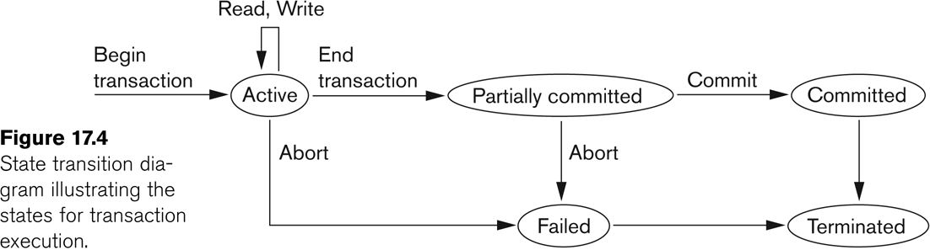
State transition diagram illustrating the states for transaction execution

Slide 12
4. Concurrent Executions & Schedules
Multiple transactions are allowed to run concurrently in the system. Advantages are:
  increased processor and disk utilization, leading to better transaction throughput: one transaction can be using the CPU while another is reading from or writing to the disk
  reduced average response time for transactions: short transactions need not wait behind long ones.
Concurrency control schemes – mechanisms to achieve isolation, i.e., to control the interaction among the concurrent transactions in order to prevent them from destroying the consistency of the database

Slide 13
4. Concurrent Executions & Schedules (cont’d)
Schedules – sequences that indicate the chronological order in which instructions of concurrent transactions are executed
  a schedule for a set of transactions must consist of all instructions of those transactions
  must preserve the order in which the instructions appear in each individual transaction.

Slide 14
Scheduling Transactions
4. Concurrent Executions & Schedules (cont’d)
Serial schedule: Schedule that does not interleave the actions of different transactions.
Equivalent schedules: For any database state, the effect (on the set of objects in the database) of executing the first schedule is identical to the effect of executing the second schedule.
Serializable schedule: A schedule that is equivalent to some serial execution of the transactions.
(Note: If each transaction preserves consistency, every serializable schedule preserves consistency. )

Slide 15
Example Schedules
Let T₁ transfer $50 from A to B, and T₂ transfer 10% of the balance from A to B. The following is a serial schedule (Schedule 1 in the text), in which T₁ is followed by T₂.
T1 | T2
Read(a) A := A – 50 Write(A) Read(B) B:= B+50 Write(B) Commit | Read(A) A:= A – A*0.1 Write(A) Read(B) B := B – B *0.1 Write(B) Commit

Slide 16
Example Schedule (Cont’d)
Let T₁ and T₂ be the transactions defined previously. The following schedule (Schedule 2 in the text) is not a serial schedule, but it is equivalent to Schedule 1.
S.1
T1 | T2
Read(a) A := A – 50 Write(A) Read(B) B:= B+50 Write(B) Commit | Read(A) A:= A – A*0.1 Write(A) Read(B) B := B +B *0.1 Write(B) Commit
S.2
T1 | T2
Read(a) A := A – 50 Write(A) Read(B) B:= B+50 Write(B) Commit | Read(A) A:= A – A*0.1 Write(A) Read(B) B := B +B *0.1 Write(B) Commit
In both Schedule 1 and 2, the sum A + B is preserved.

Slide 17
Example Schedules (cont’d)
The following concurrent schedule (Schedule 3 in the text) does not preserve the value of the the sum A + B.
T1 | T2
Read(a) A := A – 50 Write(A) Read(B) B:= B+50 Write(B) Commit | Read(A) A:= A – A*0.1 Write(A) Read(B) B := B +B *0.1 Write(B) Commit
T1 | T2
Read(a) A := A – 50 Write(A) Read(B) B:= B+50 Write(B) Commit | Read(A) A:= A – A*0.1 Write(A) Read(B) B := B +B *0.1 Write(B) Commit

Slide 18
Serializability
Basic Assumption – Each transaction preserves database consistency.
Thus serial execution of a set of transactions preserves database consistency.
A (possibly concurrent) schedule is serializable if it is equivalent to a serial schedule. Different forms of schedule equivalence give rise to the notions of:
  1. conflict serializability
  2. view serializability
We ignore operations other than read and write instructions, and we assume that transactions may perform arbitrary computations on data in local buffers in between reads and writes. Our simplified schedules consist of only read and write instructions.

Slide 19
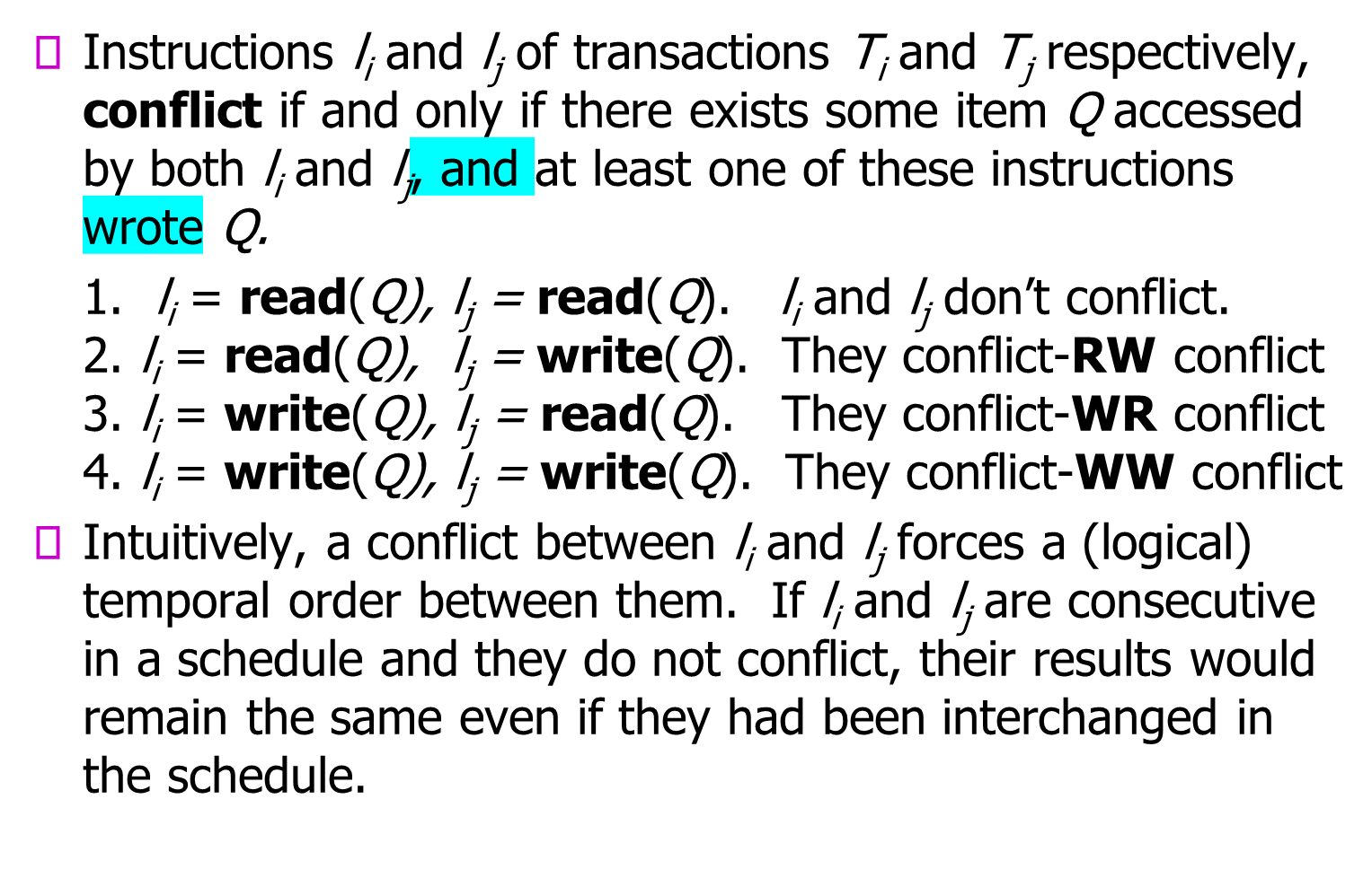
Conflict Serializability

Slide 20
Conflict Serializability(cont’d)
a serial schedule a WR-conflict schedule
T1 | T2
Read(a) A := A – 50 Write(A) Read(B) B:= B+50 Write(B) Commit | Read(A) A:= A – A*0.1 Write(A) Read(B) B := B – B *0.1 Write(B) Commit
T1 | T2
Read(a) A := A – 50 Write(A) Read(B) B:= B+50 Write(B) Commit | Read(A) A:= A – A*0.1 Write(A) Read(B) B := B – B *0.1 Write(B) Commit

Slide 21
Conflict Serializability (cont’d)
If a schedule S can be transformed into a schedule S´ by a series of swaps of non-conflicting instructions, we say that S and S´ are conflict equivalent.
We say that a schedule S is conflict serializable if it is conflict equivalent to a serial schedule
Example of a schedule that is not conflict serializable:
T₃ T₄
read(Q)
write(Q)
write(Q)
We are unable to swap instructions in the above schedule to obtain either the serial schedule <T₃, T₄ >, or the serial schedule < T₄, T₃ >.

Slide 22
Conflict Serializability (Cont’d)
Schedule 4 below can be transformed into Schedule 1, a serial schedule where T₂ follows T₁, by series of swaps of non-conflicting instructions. Therefore Schedule 4 is conflict serializable.
Schedule 1
T1 | T2
Read(a) A := A – 50 Write(A) Read(B) B:= B+50 Write(B) Commit | Read(A) A:= A – A*0.1 Write(A) Read(B) B := B – B *0.1 Write(B) Commit
T1 | T2
Read(a) A := A – 50 Write(A) Read(B) B:= B+50 Write(B) Commit | Read(A) A:= A – A*0.1 Write(A) Read(B) B := B – B *0.1 Write(B) Commit
Schedule 4

Slide 23
View Serializability
Let S and S´ be two schedules with the same set of transactions. S and S´ are view equivalent if the following three conditions are met:
  1. For each data item Q, if transaction T_{i} reads the initial value of Q in schedule S, then transaction T_{i} must, in schedule S´, also read the initial value of Q.
  2. For each data item Q, if transaction T_{i} executes read(Q) in schedule S, and that value was produced by transaction T_{j} (if any), then transaction T_{i} in schedule S´ must also read the value of Q that was produced by transaction T_{j} .
  3. For each data item Q, the transaction (if any) that performs the final write(Q) operation in schedule S must perform the final write(Q) operation in schedule S´.
As can be seen, view equivalence is also based purely on reads and writes alone.

Slide 24
View Serializability (Cont’d)
A schedule S is view serializable if it is view equivalent to a serial schedule.
Every conflict serializable schedule is also view serializable, although the converse is not true.
Schedule 9 — a schedule which is view-serializable but not conflict serializable.
Every view serializable schedule that is not conflict serializable has blind writes.
Schedule 9
Serial Schedule
T3 | T4 | T6
Read(Q) Write(Q) | Write(Q) | Write(Q)
T3 | T4 | T6
Read(Q) Write(Q) | Write(Q) | Write(Q)

Slide 25
5. Recoverability
Need to address the effect of transaction failures on concurrently running transactions.
Recoverable schedule — if a transaction T_{j} reads a data items previously written by a transaction T_{i} , the commit operation of T_{i} appears before the commit operation of T_{j}.
The following schedule (Schedule 11) is not recoverable if T₉ commits immediately after the read
If T₈ should abort, T₉ would have read (and possibly shown to the user) an inconsistent database state. Hence database must ensure that schedules are recoverable.
T8 | T9
Read(A) Write(A) Read(B) Commit | Read(A) Commit

Slide 26
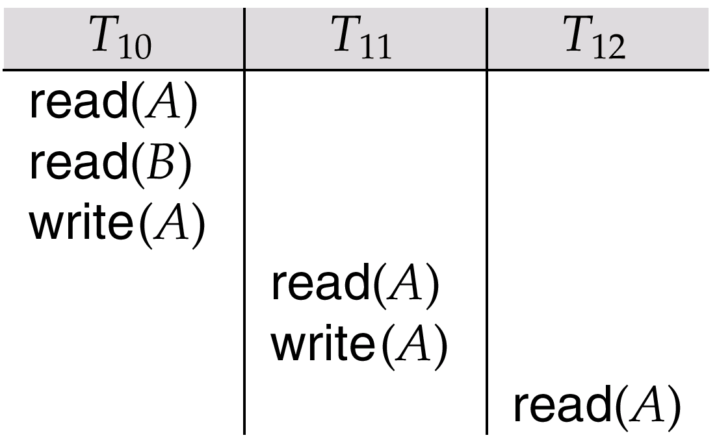
5. Recoverability (Cont’d)
Cascading rollback – a single transaction failure leads to a series of transaction rollbacks. Consider the following schedule where none of the transactions has yet committed (so the schedule is recoverable)
If T₁₀ fails, T₁₁ and T₁₂ must also be rolled back.
Can lead to the undoing of a significant amount of work

Slide 27
5. Recoverability (Cont’d)
Cascadeless schedules — cascading rollbacks cannot occur; for each pair of transactions T_{i} and T_{j} such that T_{j} reads a data item previously written by T_{i} , the commit operation of T_{i} appears before the read operation of T_{j} (i.e., transactions may read only values written by committed transactions.)
Every cascadeless schedule is also recoverable.
T8 | T9
Read(A) Write(A) Commit | Write(B) Read(A) Commit

Slide 28
6.Lock-Based Concurrency Control
The most widely used locking protocol, called Strict Two-Phase Locking, or Strict 2PL, has two rules:
If a transaction T wants to read (respectively, modify) an object, it first requests a shared (respectively, exclusive) lock on the object.
All locks held by a transaction are released when the transaction is completed.
(Non-strict) 2PL Variant: Release locks anytime, but cannot acquire locks after releasing any lock.
If an Xact holds an X lock on an object, no other Xact can get a lock (S or X) on that object.

Slide 29
6.Lock-Based Concurrency Control (cont’d)
The recovery manager of a DBMS is responsible for ensuring transaction atomicity and durability. It ensures atomicity by undoing the actions of transactions that do not commit and durability by making sure that all actions of committed transactions survive system crashes, (e.g., a core dump caused by a bus error) and media failures (e.g., a disk is corrupted).
Strict 2PL allows only serializable schedules.

Slide 30
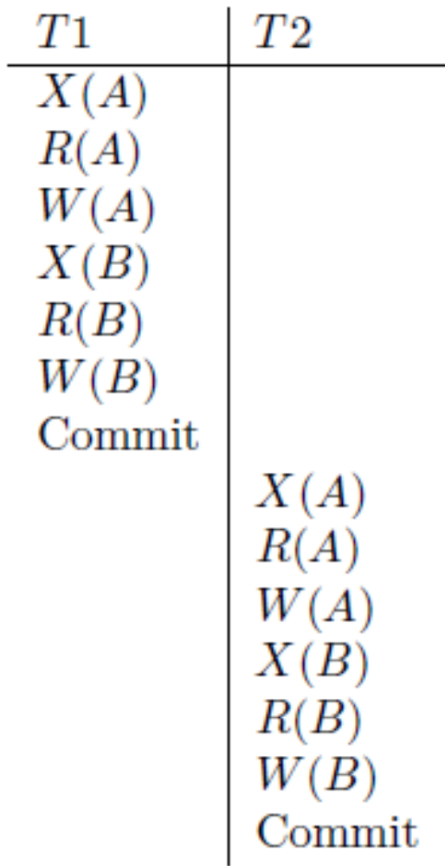
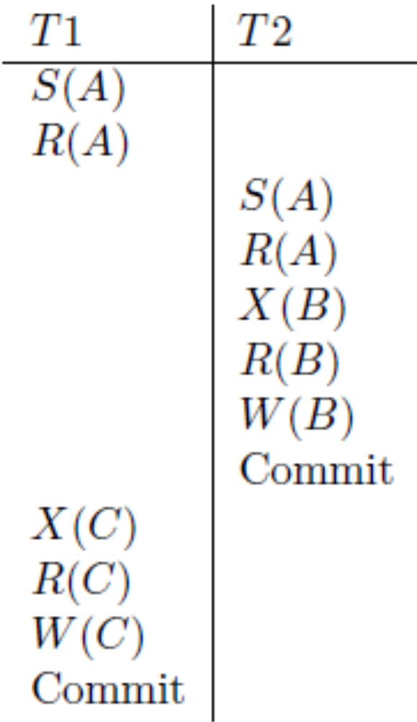
6.Lock-Based Concurrency Control (cont’d)
Following schedules illustrating Strict 2PL with Serial Execution and Interleaved Actions

Slide 31
Aborting a Transaction
If a transaction Ti is aborted, all its actions have to be undone. Not only that, if Tj reads an object last written by Ti, Tj must be aborted as well!
Most systems avoid such cascading aborts by releasing a transaction’s locks only at commit time.
  If Ti writes an object, Tj can read this only after Ti commits.
In order to undo the actions of an aborted transaction, the DBMS maintains a log in which every write is recorded. This mechanism is also used to recover from system crashes: all active Xacts at the time of the crash are aborted when the system comes back up.

Slide 32
The Log
The following actions are recorded in the log:
  Ti writes an object: the old value and the new value.
    Log record must go to disk before the changed page!
  Ti commits/aborts: a log record indicating this action.
Log records are chained together by Xact id, so it’s easy to undo a specific Xact.
Log is often duplexed and archived on stable storage.
All log related activities (and in fact, all CC related activities such as lock/unlock, dealing with deadlocks etc.) are handled transparently by the DBMS.

Slide 33
7. Recovering From a Crash
When the recovery manager is invoked after a crash, restart proceeds in 3 phases (the Aries recovery algorithm):
  Analysis: Scan the log forward (from the most recent checkpoint) to identify all Xacts that were active at the time of the crash, and all dirty pages (i.e., changes that have not been written to disk) in the buffer pool at the time of the crash.
  Redo: Redoes all updates to dirty pages in the buffer pool, as needed (i.e., applied only to committed transactions. Additionally, information stored by ARIES and in the data pages will allow ARIES to determine whether the operation to be redone has actually been applied to the database and therefore does not need to be reapplied), to ensure that all logged updates are in fact carried out and written to disk.

Slide 34
7. Recovering From a Crash (contd.)
  Undo: The log is scanned backward and the operations of transactions that were active at the time of the crash are undone in reverse order. (Some care must be taken to handle the case of a crash occurring during the recovery process!)

Slide 35
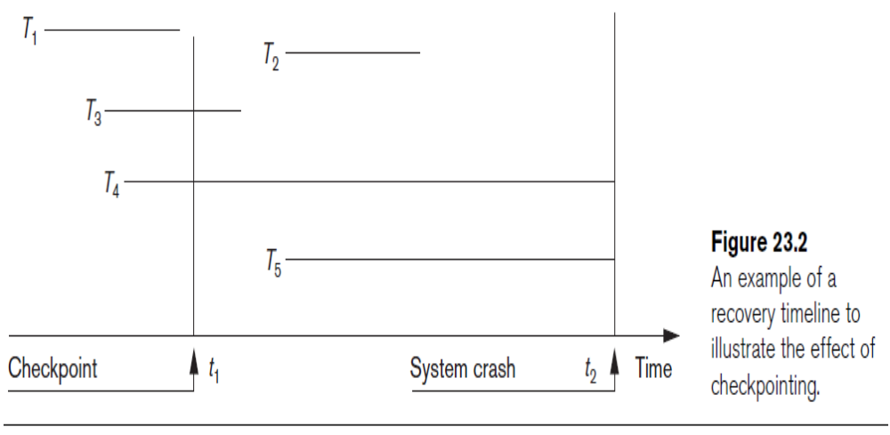
Example
Notes:
LSN: Log Sequence Number

Slide 36
assignment
There are many more details, and the newer standards have more commands for transaction processing.
Let study them in SQL Server and Oracles

Slide 37
Steps in a Transaction
Transaction support in SQL
Step 1: Transaction starts with the BEGIN TRANSACTION statement
Step 2: When the INSERT, SELECT, UPDATE, or DELETE statement is detected, SQL Server allocates a new transaction ID, and creates a log record in the memory
Step 3: All altered rows are recorded in the logs, and the data page is then changed in memory

Slide 38
Steps in a Transaction (contd.)
Step 4: The COMMIT TRANSACTION statement writes the records to the transaction log of the database
(or The statement ROLLBACK causes the transaction to end, but by aborting.)
Step 5: Changes are applied to the database
(or No effects on the database)

Slide 39
COMMIT
The SQL statement COMMIT causes a transaction to complete.
  It’s database modifications are now permanent in the database.

Slide 40
ROLLBACK
The SQL statement ROLLBACK also causes the transaction to end, but by aborting.
  No effects on the database.
Failures like division by 0 or a constraint violation can also cause rollback, even if the programmer does not request it.

Slide 41
Types of Transaction
Explicit
Implicit
Autocommit

Slide 42
Explicit Transaction
Manually configured transaction, in which the user clearly defines the beginning and end of the transaction
Use BEGIN TRANSACTION to start
Use COMMIT TRANSACTION or COMMIT WORK to successfully complete
Use ROLLBACK TRANSACTION or ROLLBACK WORK to cancel

Slide 43
Implicit Transactions
Enabled with the
SET IMPLICIT_TRANSACTIONS ON statement
When enabled, SQL Server starts the implicit transaction whenever it encounters the following keywords:
ALTER TABLE
REVOKE
CREATE
SELECT
DELETE
INSERT
UPDATE
DROP
OPEN
FETCH
TRUNCATE TABLE
GRANT

Slide 44
Autocommit Transactions
Default transaction management mode
Every statement is committed or rolled back when it is completed

Slide 45
Example: Interacting Processes
Assume the usual Sells(bar,beer,price) relation, and suppose that Joe’s Bar sells only Bud for $2.50 and Miller for $3.00.
Sally is querying Sells for the highest and lowest price Joe charges.
Joe decides to stop selling Bud and Miller, but to sell only Heineken at $3.50.

Slide 46
Sally’s Program
Sally executes the following two SQL statements called (min) and (max) to help us remember what they do.
(max) SELECT MAX(price) FROM Sells
WHERE bar = ’Joe’’s Bar’;
(min) SELECT MIN(price) FROM Sells
WHERE bar = ’Joe’’s Bar’;

Slide 47
Joe’s Program
At about the same time, Joe executes the following steps: (del) and (ins).
(del) DELETE FROM Sells
WHERE bar = ’Joe’’s Bar’;
(ins) INSERT INTO Sells
VALUES(’Joe’’s Bar’, ’Heineken’, 3.50);

Slide 48
Interleaving of Statements
Although (max) must come before (min), and (del) must come before (ins), there are no other constraints on the order of these statements, unless we group Sally’s and/or Joe’s statements into transactions.

Slide 49
Example: Strange Interleaving
Suppose the steps execute in the order (max)(del)(ins)(min).
Joe’s Prices:
Statement:
Result:
Sally sees MAX < MIN!
{2.50,3.00}
{2.50,3.00}
{3.50}
(max)
(del)
(ins)
(min)
3.00
3.50

Slide 50
Fixing the Problem by Using Transactions
If we group Sally’s statements (max)(min) into one transaction, then she cannot see this inconsistency.
She sees Joe’s prices at some fixed time.
  Either before or after he changes prices, or in the middle, but the MAX and MIN are computed from the same prices.

Slide 51
Another Problem: Rollback
Suppose Joe executes (del)(ins), not as a transaction, but after executing these statements, thinks better of it and issues a ROLLBACK statement.
If Sally executes her statements after (ins) but before the rollback, she sees a value, 3.50, that never existed in the database.

Slide 52
Solution
If Joe executes (del)(ins) as a transaction, its effect cannot be seen by others until the transaction executes COMMIT.
  If the transaction executes ROLLBACK instead, then its effects can never be seen.

Slide 53
Isolation Levels
SQL defines four isolation levels = choices about what interactions are allowed by transactions that execute at about the same time.
Only one level (“serializable”) = ACID transactions.
Each DBMS implements transactions in its own way.

Slide 54
Choosing the Isolation Level
Within a transaction, we can say:
SET TRANSACTION ISOLATION LEVEL X
where X =
  SERIALIZABLE
  REPEATABLE READ
  READ COMMITTED
  READ UNCOMMITTED

Slide 55
Serializable Transactions
If Sally = (max)(min) and Joe = (del)(ins) are each transactions, and Sally runs with isolation level SERIALIZABLE, then she will see the database either before or after Joe runs, but not in the middle.

Slide 56
Isolation Level Is Personal Choice
Your choice, e.g., run serializable, affects only how you see the database, not how others see it.
Example: If Joe Runs serializable, but Sally doesn’t, then Sally might see no prices for Joe’s Bar.
  i.e., it looks to Sally as if she ran in the middle of Joe’s transaction.

Slide 57
Read-Commited Transactions
If Sally runs with isolation level READ COMMITTED, then she can see only committed data, but not necessarily the same data each time.
Example: Under READ COMMITTED, the interleaving (max)(del)(ins)(min) is allowed, as long as Joe commits.
  Sally sees MAX < MIN.

Slide 58
Repeatable-Read Transactions
Requirement is like read-committed, plus: if data is read again, then everything seen the first time will be seen the second time.
  But the second and subsequent reads may see more tuples as well.

Slide 59
Example: Repeatable Read
Suppose Sally runs under REPEATABLE READ, and the order of execution is (max)(del)(ins)(min).
  (max) sees prices 2.50 and 3.00.
  (min) can see 3.50, but must also see 2.50 and 3.00, because they were seen on the earlier read by (max).

Slide 60
Read Uncommitted
A transaction running under READ UNCOMMITTED can see data in the database, even if it was written by a transaction that has not committed (and may never).
Example: If Sally runs under READ UNCOMMITTED, she could see a price 3.50 even if Joe later aborts.

Slide 61
Example
EXEC SQL WHENEVER SQLERROR GOTO UNDO;
EXEC SQL SET TRANSACTION
READ WRITE
DIAGNOSTIC SIZE 5
ISOLATION LEVEL SERIALIZABLE;
EXEC SQL INSERT INTO EMPLOYEE (Fname, Lname, Ssn, Dno, Salary) VALUES ('Robert', 'Smith', '991004321', 2, 35000);
EXEC SQL UPDATE EMPLOYEE
SET Salary = Salary * 1.1 WHERE Dno = 2;
EXEC SQL COMMIT;
GOTO THE_END;
UNDO: EXEC SQL ROLLBACK;
THE_END: ... ;

Slide 62
assignment
There are many more details, and the newer standards have more commands for transaction processing.
Let study them in SQL Server and Oracles

